Slide 1





YouTube
Summary
A YouTube Transcript Summarizer Extension
GROUP MEMBERS
Roll Number
Zaira Fatima 2116367
Shamini Bhatt 2116297
Sukriti Agrawal 2116327
Yashika Gupta 2116366
Group ID:
CS15

Slide 2




AGENDA
Introduction
Technologies Used
Requirements
Use Cases
Architecture
Class Diagram
Database Description
Sequence Diagram
Activity Diagram
User Interface

Slide 3


Overview
The YouTube Transcript Summarizer is a Chrome Extension.
It will be used for writing the transcript of any YouTube video which has subtitles.
It will allow the user to summarize the transcript of the video in a simple and crisp form.
Functionality:
The extension will extract subtitles from YouTube videos as transcripts.
It will then generate concise summaries of these transcriptions.
Users can choose to translate the summaries into Hindi.

Slide 4



Technologies Used
Frontend
Backend
PYTHON
FLASK
HUGGING FACE
YOUTUBE API
FIREBASE
HTML
CSS
JAVASCRIPT

Slide 5



REQUIREMENTS
Chrome Browser: The Chrome extension will run within the Chrome web browser, so it's essential that the user's computer has the Google Chrome browser installed.
User Input Devices: Users will interact with the extension using standard input devices like a keyboard and mouse
User Input Devices: Users will require to have a stable Internet Connection to be able to use this extemsion

Slide 6

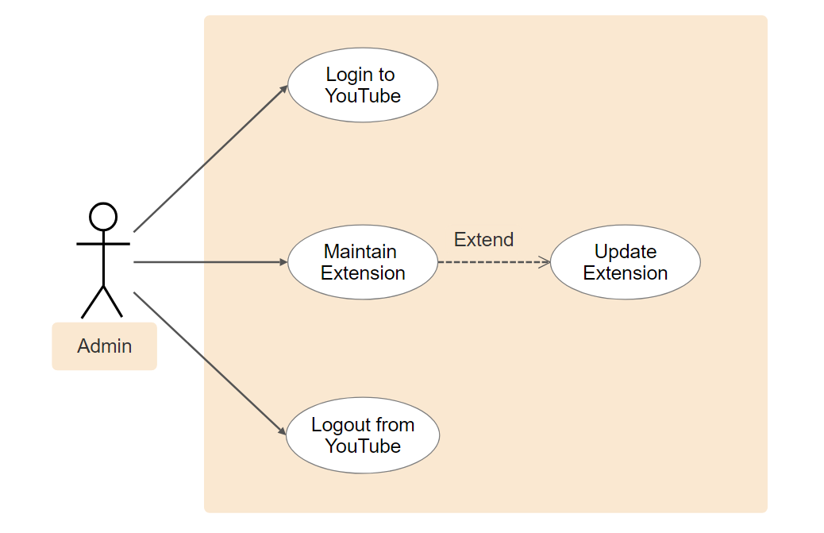

USE CASE DIAGRAMS
use case for
ADMIN

Slide 7
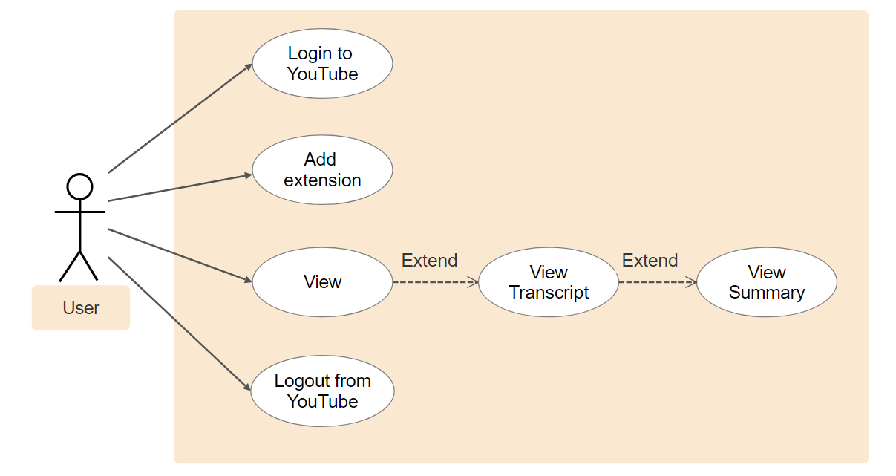
USE CASE DIAGRAMS
use case for
USER

Slide 8
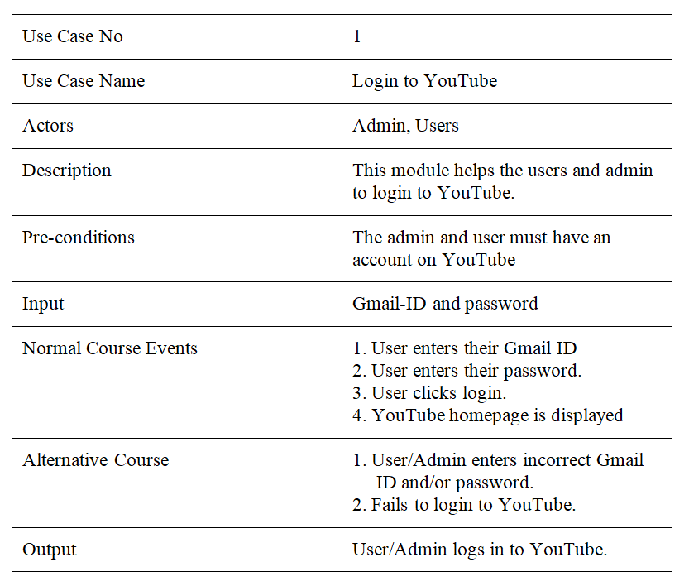

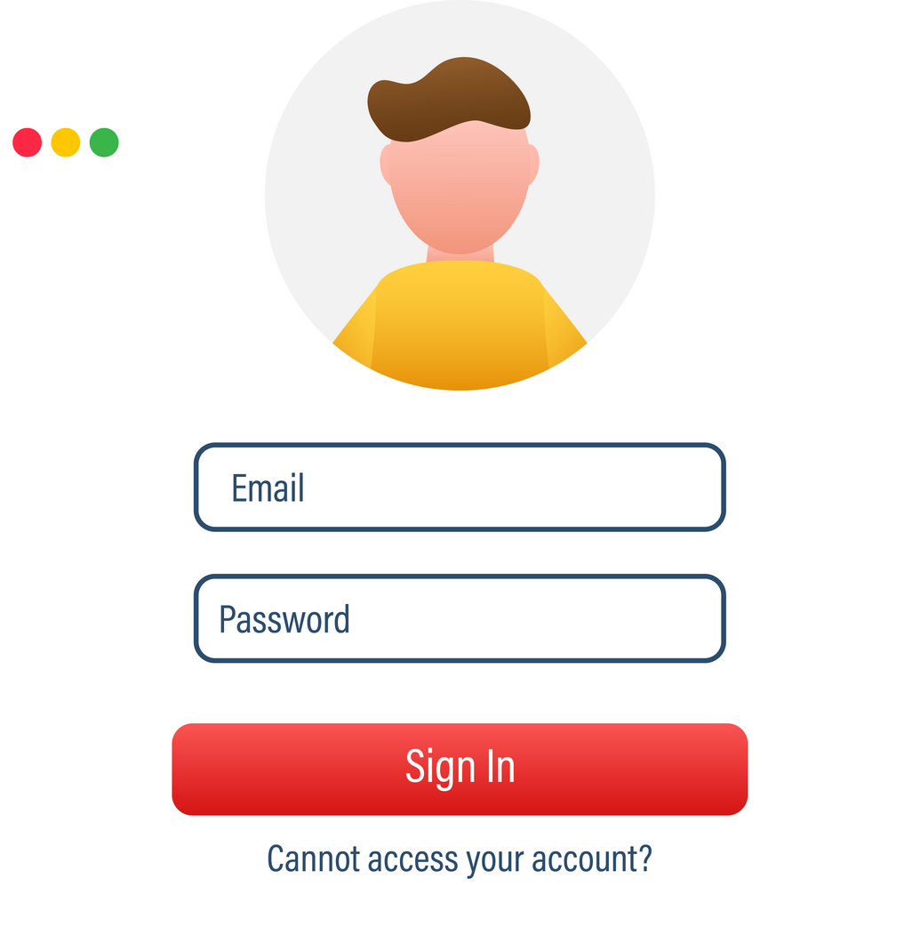
USE CASE
TABLES

Slide 9
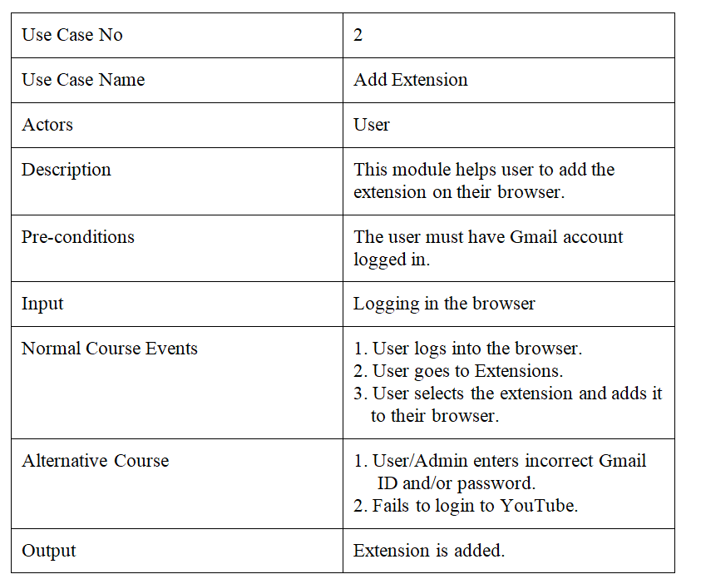


USE CASE
TABLES

Slide 10
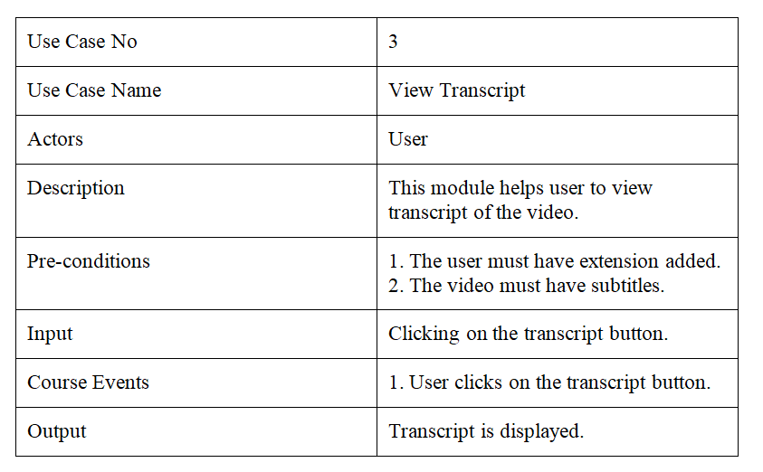

USE CASE
TABLES

Slide 11
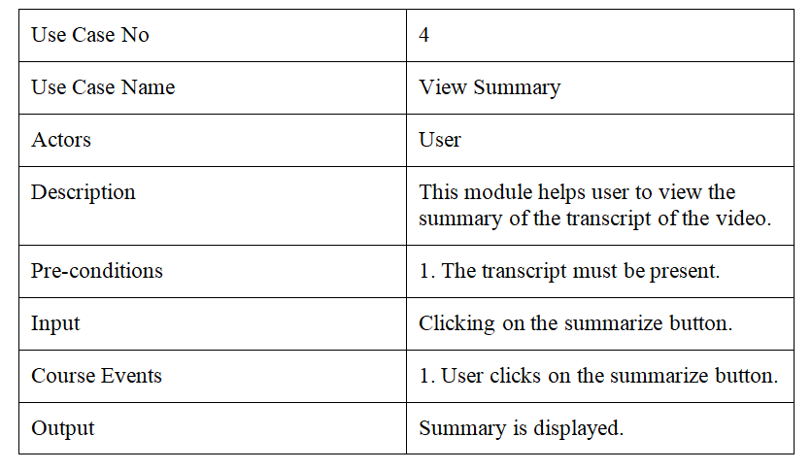

USE CASE
TABLES

Slide 12
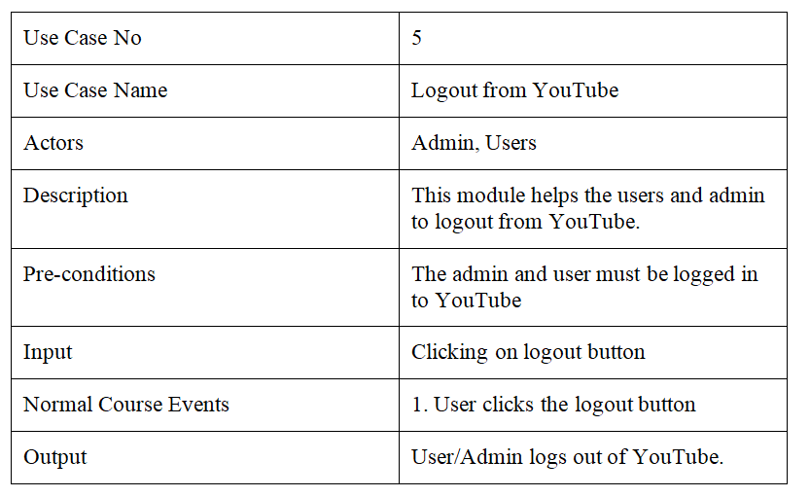

USE CASE
TABLES

Slide 13



Two-Tier Architecture
Extension User Interface Content Script: Extension User Interface Content Script represents components within the client tier (the Chrome Browser) of your architecture
1. Client Tier: This represents the user's web browser, where the Chrome extension runs. In our case, it's the primary interface through which users interact with your extension
2. Server Tier: This represents external services or APIs that your extension interacts with. This can include services like YouTube's API for video data and transcripts.

Slide 14
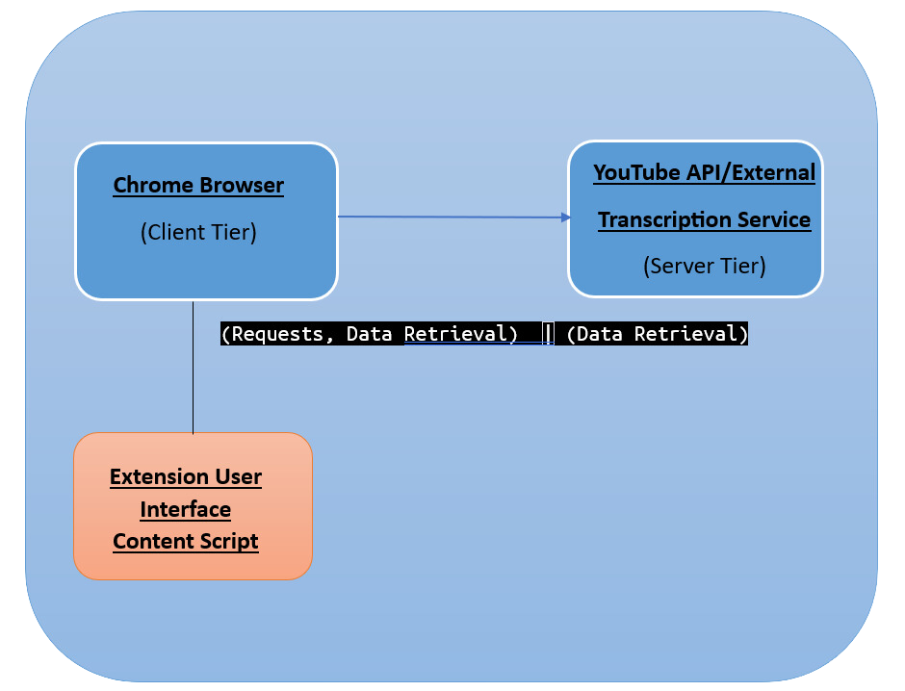
Two-Tier Architecture

Slide 15
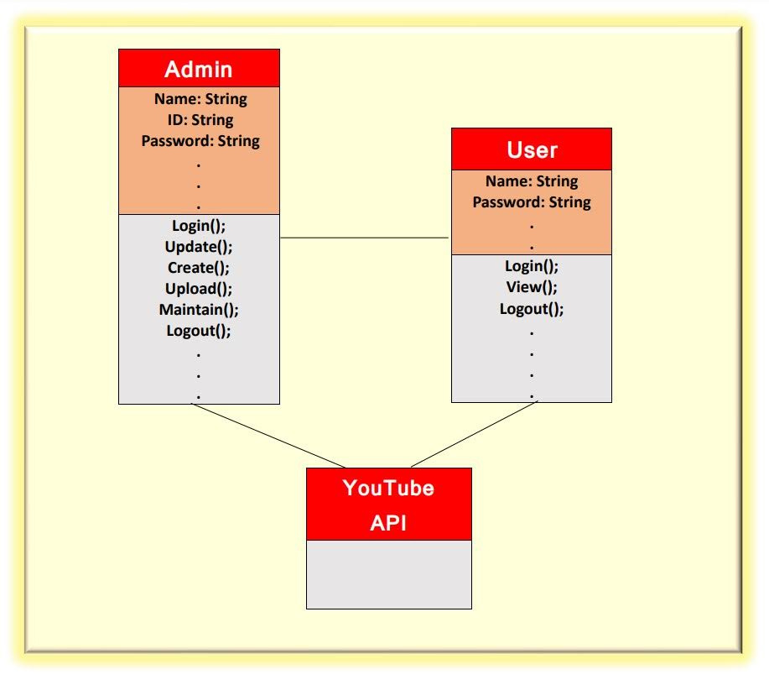

CLASS DIAGRAM

Slide 16


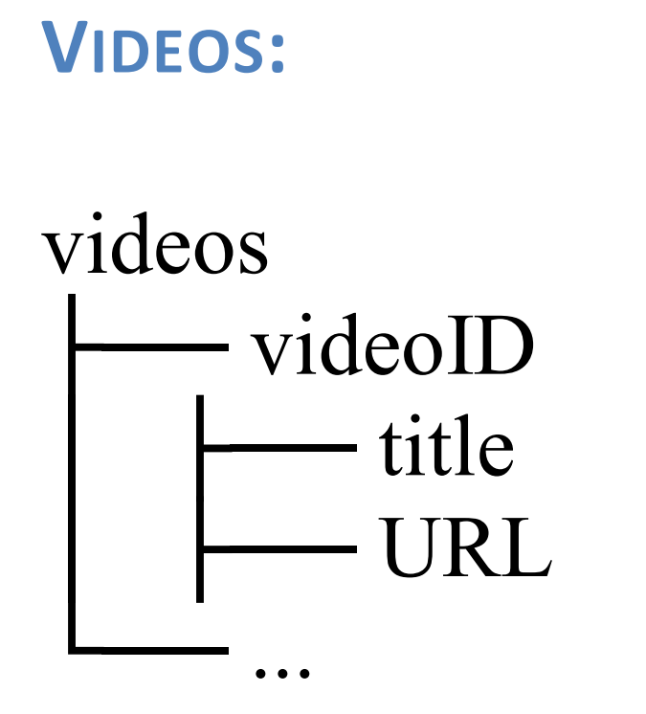
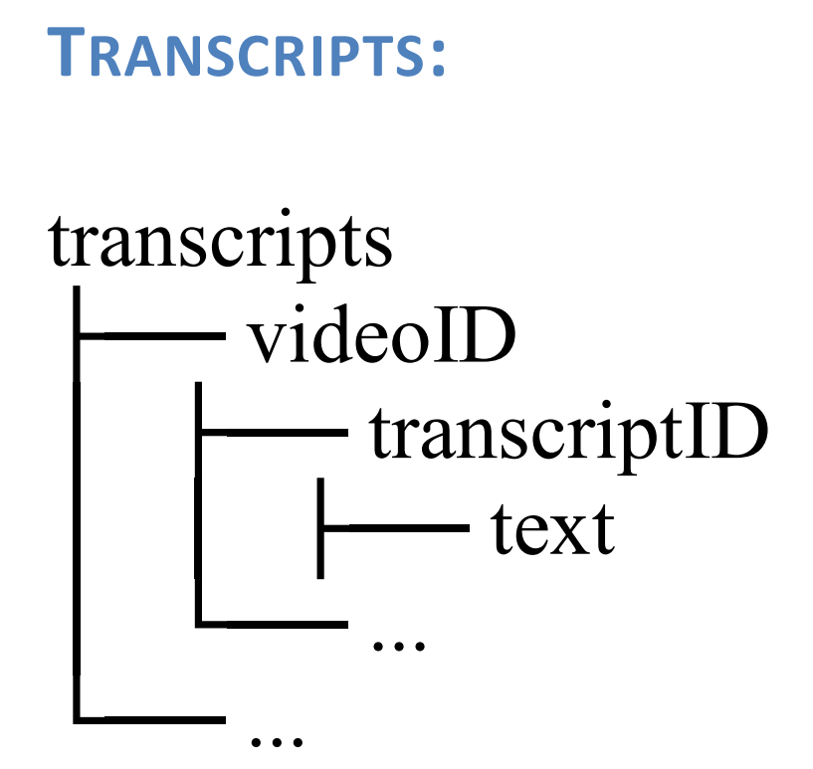
DATABASE DESCRIPTION
Videos
Transcripts

Slide 17
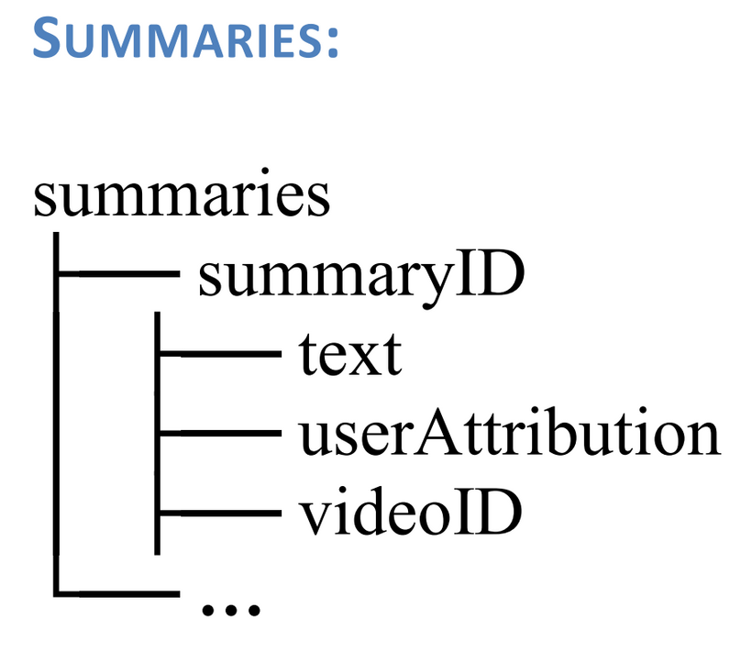
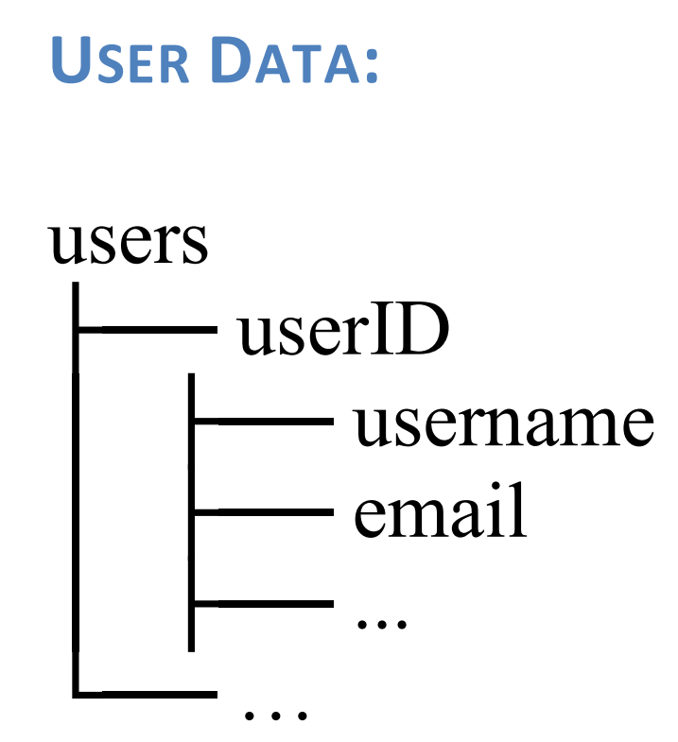
DATABASE DESCRIPTION
Summaries
User Data

Slide 18
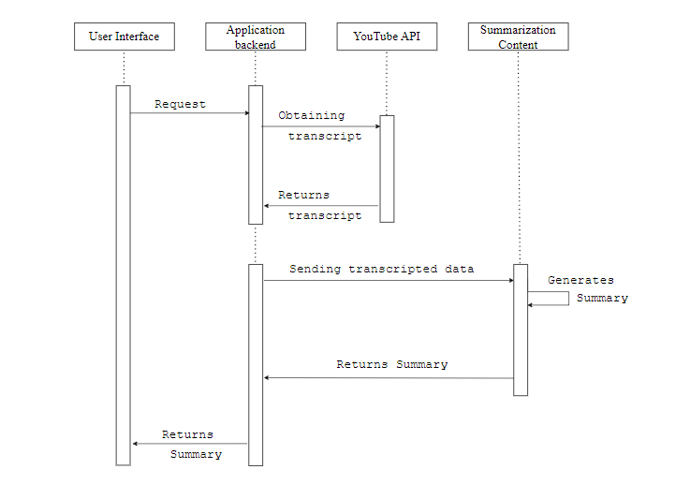

SEQUENCE DIAGRAM

Slide 19




Open the Extension
Click et Transcript
Click on Summarize
ACTIVITY DIAGRAM
Click on Translate
Click on Listen
Exit

Slide 20



USER INTERFACE
Home Page of Extension

Slide 21

USER INTERFACE
Transcript page

Slide 22

USER INTERFACE
Summary Page

Slide 23

USER INTERFACE
Translation Page

Slide 24

References
G. Begum, N. Musrat Sultana, and D. Ashritha, “YOUTUBE TRANSCRIPT SUMMARIZER.” Accessed: Oct. 3, 2023. [Online]. Available: https://ijcrt.org/papers/IJCRT22A6393.pdf
B. Saji, “Creating a YouTube Summarizer - Mini NLP Project,” Analytics Vidhya, Jan. 13, 2022. https://www.analyticsvidhya.com/blog/2022/01/youtube-summarizer-mini-nlp project/ (accessed Oct. 1 2023).
“YouTube Video Transcript Summarization | Projects,” www.youtube.com. https://youtu.be/3VMJhJvRWg?si=3UxVgSstYXbNXFqU (accessed Oct. 5, 2023).
S. Jain, J. Jain, G. Kaur, Y. Rani, "YouTube Transcript Summarizer", _International Journal of Science and Research_, vol. 12 issue 2, February 202

